Slide 1
Lesson – 5 Advanced UI components

Slide 2
Agenda
AutoCompleteTextView(ACTV)
Spinner
ListView
Adapters – ArrayAdapter(API)
Adapters – Custom Adapter(User Defined)
Menus & ActionBar
Dialogs
Notifications

Slide 3
Day - 1

Slide 4
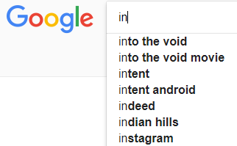
AutoCompleteTextView
The AutoCompleteTextView is sort of a hybrid between the EditText (field) and the Spinner. With auto-completion, as the user types, the text is treated as a prefix filter, comparing the entered text as a prefix against a list of candidates.
Matches are shown in a selection list that folds down from the field. The user can either type out an entry (e.g., something not in the list) or choose an entry from the list to be the value of the field.
In addition, AutoCompleteTextView has an Threshold property, to indicate the minimum number of characters a user must enter before the list filtering begins.
To create a UI Component use <AutoCompleteTextView> tag in XML.
To provide an auto completion support to the user first we have to configure the values. Configure the values either using
XML approach or Java approach.

Slide 5
XML Approach
Step 1: In your Android Project go to the folder app→res→values→strings.xml
Set the values by using the given lines of codes
<string-array name=“array_name”>
<item>value1</item>
<item>value2</item>
………….
</string-array>
Step 2: Create an AutoCompleteTextView UI component in XML with an id.
Step 3: Use the following code to get the Xml configured values into your Activity.
String[] values=getResources().getStringArray(R.array.array_name);
Step 4: for presenting the values we have to create an Adapter, in Android there are 3 types of Adapters.
a) ArrayAdapter b) Custom Adapter(will discuss in ListView) c) Cursor Adapter(will discuss in SQLite)
ArrayAdapter<String> adapter= new ArrayAdapter<String>(context,xml_file,values);
actv.setAdapter(adapter); // To specify the Adapter Object. Here actv is an Autocomplete TextView type
actv.setThreshold(int); // To specify the dropdown support, after how many characters of user entry
Notes:
Context : It allows access to application-specific resources and classes, as well as up-calls for application-level operations such as launching activities, broadcasting and receiving intents, etc.

Slide 6
Hands-on-example – Countries list using ACTV
strings.xml
<resources> <string name="app_name">ACTVDemo</string> <string-array name="countries"> <item>India</item> <item>Indonasia</item> <item>USA</item> <item>Asia</item> <item>Africa</item> <item>Siria</item> <item>Sri Lanka</item> <item>Canada</item> <item>Koria</item> <item>Island</item> <item>Bangaladesh</item> <item>Nepal</item> </string-array> </resources>
XML Code
<LinearLayout xmlns:android="http://schemas.android.com/apk/res/android" android:layout_width="match_parent" android:layout_height="match_parent" android:orientation="vertical"> <TextView android:layout_width="match_parent" android:layout_height="wrap_content" android:text="Enter Text : " android:textSize="20sp" android:textStyle="bold" android:textColor="#008888" /> <AutoCompleteTextView android:layout_width="match_parent" android:layout_height="wrap_content" android:id="@+id/actv"/> </LinearLayout>

Slide 7
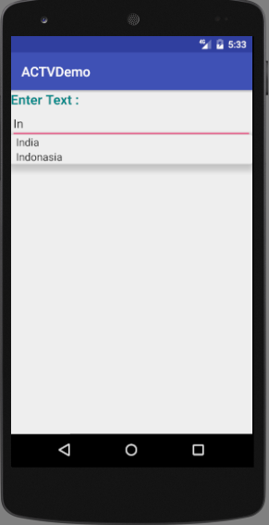
Output
public class MainActivity extends AppCompatActivity { AutoCompleteTextView actv; @Override protected void onCreate(Bundle savedInstanceState) { super.onCreate(savedInstanceState); setContentView(R.layout.activity_main); actv = (AutoCompleteTextView) findViewById(R.id.actv); // Get the XML configured vales into the Activity and stored into an String Array String[] values = getResources().getStringArray(R.array.countries); /* Pass three parameters to the ArrayAdapter 1. The current context, 2. The resource ID for a built-in layout file containing a TextView to use when instantiating views, which are available in android.R.layout 3. The objects to represent in the values */ ArrayAdapter<String> adapter = new ArrayAdapter<String>(this,android.R.layout.simple_spinner_item,values); actv.setAdapter(adapter); actv.setThreshold(2); // by default 1 } }

Slide 8
Java Approach & OnItemClickListener
public class MainActivity extends AppCompatActivity { AutoCompleteTextView actv; @Override protected void onCreate(Bundle savedInstanceState) { super.onCreate(savedInstanceState); setContentView(R.layout.activity_main); actv = (AutoCompleteTextView) findViewById(R.id.actv); String[] values = new String[]{"Asia","Australia","America","Belgium","Brazil","Canada","California","Dubai","France","Paris" }; ArrayAdapter<String> adapter = new ArrayAdapter<String>(this,android.R.layout.simple_spinner_item,values); actv.setAdapter(adapter); actv.setThreshold(2); // by default 1 actv.setOnItemClickListener(new AdapterView.OnItemClickListener() { @Override public void onItemClick(AdapterView<?> parent, View view, int position, long id) { Toast.makeText(getApplicationContext(),"Item selected is : "+parent.getItemIdAtPosition(position),Toast.LENGTH_LONG).show(); } }); } }
Notes:
void onItemClick (AdapterView<?> parent, View view, int position, long id)
Parameters
Parent - AdapterView: The AdapterView where the click happened.
View: The view within the AdapterView that was clicked (this will be a view provided by the adapter)
Position - int: The position of the view in the adapter.
Id: long: The row id of the item that was clicked.

Slide 9
Toast is one of the notification method in Android which is used to display text on the screen for few seconds.
Toast
Toast makeText (Context context, CharSequence msg, int duration).show()
Make a standard toast that just contains a text view.
Parameters
context | Context: The context to use. Usually your Application or Activity object.
msg | CharSequence: The text to show. Can be formatted text.
duration | int: How long to display the message. Either LENGTH_SHORT or LENGTH_LONG

Slide 10
AdapterView.OnItemClickListener
Interface definition for a callback to be invoked when an item in this AdapterView has been clicked. Implementers can call getItemAtPosition(position) if they need to access the data associated with the selected item.
Public methods
abstract void | onItemClick(AdapterView<?> parent, View view, int position, long id) Callback method to be invoked when an item in this AdapterView has been clicked.
Parameters
parent | AdapterView: The AdapterView where the click happened.
view | View: The view within the AdapterView that was clicked (this will be a view provided by the adapter)
position | int: The position of the view in the adapter. (position starts from zero)
id | long: The row id of the item that was clicked.

Slide 11
Difference Between XML And Java Approach
XML Approach
To provide static data
Example : Country names are static
To provide Multi language support-I18N-(Internationalization) -(Discussed later in Localization)
Java Approach
To provide dynamic data
Example : Movies list
Can not provide Multi language support.

Slide 12
Spinners
Spinners provide a quick way to select one value from a set. In the default state, a spinner shows its currently selected value. Touching the spinner displays a dropdown menu with all other available values, from which the user can select a new one.
You can add a spinner to your layout with the Spinner object. You should usually do so in your XML layout with a <Spinner> element. For example:
<Spinner android:id="@+id/planets_spinner" android:layout_width=“match_parent" android:layout_height="wrap_content“
android:entries="@array/planets_array"
/>
Notes:
Android:entries helps to retrieve the values from string resources to the xml.
Remove this line from your AndriodManifest.xml
<application android:label="@string/app_name">

Slide 13
Populate the spinner with user choices
The choices you provide for the spinner can come from any source, but must be provided through an SpinnerAdapter, such as an ArrayAdapter if the choices are available in an array or a CursorAdapter if the choices are available from a database query.
For instance, if the available choices for your spinner are pre-determined, you can provide them with a string array defined in a string resource file:
<?xml version="1.0" encoding="utf-8"?> <resources> <string-array name="planets_array"> <item>Mercury</item> <item>Venus</item> <item>Earth</item> <item>Mars</item> <item>Jupiter</item> <item>Saturn</item> <item>Uranus</item> <item>Neptune</item> </string-array> </resources>

Slide 14
Responding to user selections
When the user selects an item from the drop-down, the Spinner object receives an on-item-selected event.
To define the selection event handler for a spinner, implement the AdapterView.OnItemSelectedListener interface and the corresponding onItemSelected() callback method. For example, here's an implementation of the interface in a
public class SpinnerActivity extends Activity implements OnItemSelectedListener { ... public void onItemSelected(AdapterView<?> parent, View view, int pos, long id) { // An item was selected. You can retrieve the selected item using // parent.getItemAtPosition(pos) } public void onNothingSelected(AdapterView<?> parent) { // Another interface callback } }
The AdapterView.OnItemSelectedListener requires the onItemSelected() and onNothingSelected() callback methods.
Then you need to specify the interface implementation by calling setOnItemSelectedListener():
Spinner spinner = (Spinner) findViewById(R.id.spinner);
spinner.setOnItemSelectedListener(this);
Example from Demo : Lesson5\SpinnerDemo folder

Slide 15
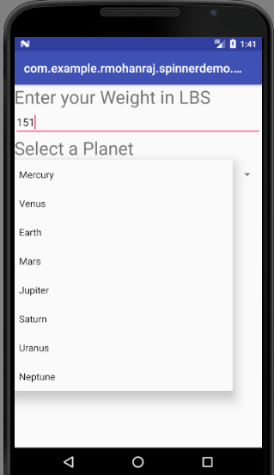
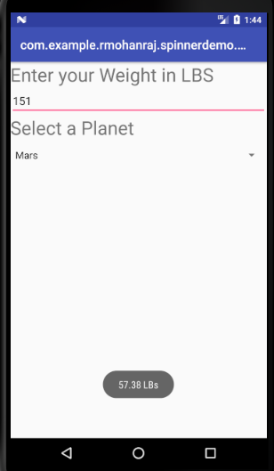
Hands on Example for Spinner - Planet Weight Calculator

Slide 16
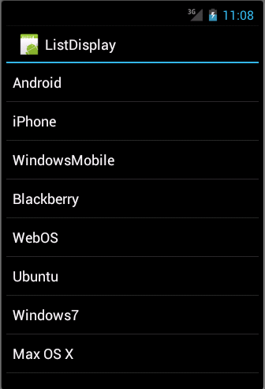
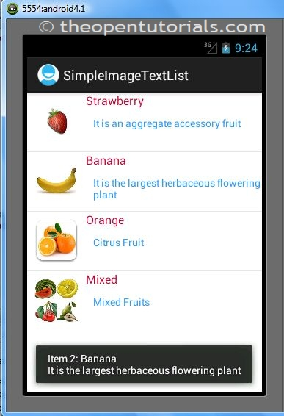
ListView
ListView is a view group that displays a list of scrollable items. An Adapter that pulls content from a source, such as, a query or an array, helps to insert the list items automatically. Each item result is converted into a View and added to the list by the Adapter.
<ListView android:id=“@android:id/list” android:layout_width=“match_parent” android:layout_height=“wrap_content” </ListView>
Simple ListView
Customized ListView

Slide 17
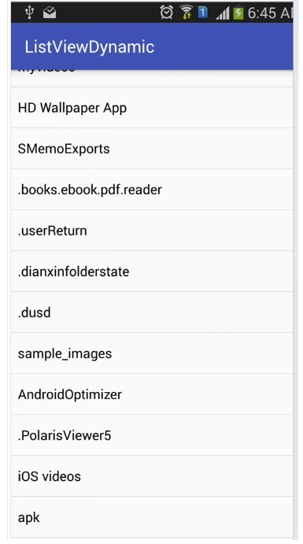
Simple ListView- Hands on Example
Problem : To get the files from the Phone and View in a ListView. We are working with Internal Storage in this lesson. Remaining will discuss later.
Android provides several storage options for you to save persistent application data.
Shared Preferences
Store private primitive data in key-value pairs.
Internal Storage
Store private data on the device memory.
External Storage
Store public data on the shared external storage.
SQLite Databases
Store structured data in a private database.
Network Connection
Store data on the web with your own network server.
Expected Screen

Slide 18
Hands on Example -Coding
activity_main.xml
<LinearLayout xmlns:android="http://schemas.android.com/apk/res/android" android:layout_width="match_parent" android:layout_height="match_parent" android:orientation="vertical"> <ListView android:layout_width="match_parent" android:layout_height="match_parent" android:id="@+id/lview1" ></ListView> </LinearLayout>

Slide 19
Hands on Example -Coding
MainActivity.java
import android.support.v7.app.AppCompatActivity; import android.os.Bundle; import android.widget.ArrayAdapter; import android.widget.ListView; import java.io.File; public class MainActivity extends AppCompatActivity { @Override protected void onCreate(Bundle savedInstanceState) { super.onCreate(savedInstanceState); setContentView(R.layout.activity_main); ListView lview=(ListView)findViewById(R.id.lview1); // Retrieve the file from the Phone Internal Memory // String path = "/storage/sdcard0/"; String path = "/storage/emulated/0/"; File f = new File(path); String[] files = f.list(); ArrayAdapter<String> adapter = new ArrayAdapter<String>(MainActivity.this,android.R.layout.simple_spinner_dropdown_item,files); lview.setAdapter(adapter); } }
To get the files from your phone internal storage use either one of the following
"/storage/sdcard0/"
"/storage/emulated/0/"

Slide 20
DAY – 2 Customized listview

Slide 21
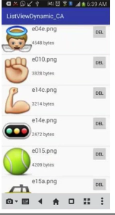
Hands on Example – Customized ListView
Problem Requirement : Display the image with file name, file size and delete button in a each row of ListView. This is called Customized View. User can change the ListView according to their own need. ArrayAdapter we can present only String type of data , if you want to present your own UI on individual , use CustomAdapter.
Steps to work with CustomAdapter :
1. Create a class with subtype of BaseAdapter. It is an abstract class having 4
abstract methods. Override the following methods in your class.
getCount(), getItem(), getItemId(), getView()
2. from Activity class set the custom adapter object to the UI component using
ui.setAdapter(new CustomAdapter());

Slide 22
Hands on Example – Customized ListView – Coding Step1
Step : 1 Design the activity_main.xml with ListView
<?xml version="1.0" encoding="utf-8"?> <LinearLayout xmlns:android="http://schemas.android.com/apk/res/android" android:layout_width="match_parent" android:layout_height="match_parent" android:orientation="vertical" > <ListView android:layout_width="match_parent" android:layout_height="match_parent" android:id="@+id/lview1" ></ListView> </LinearLayout>

Slide 23
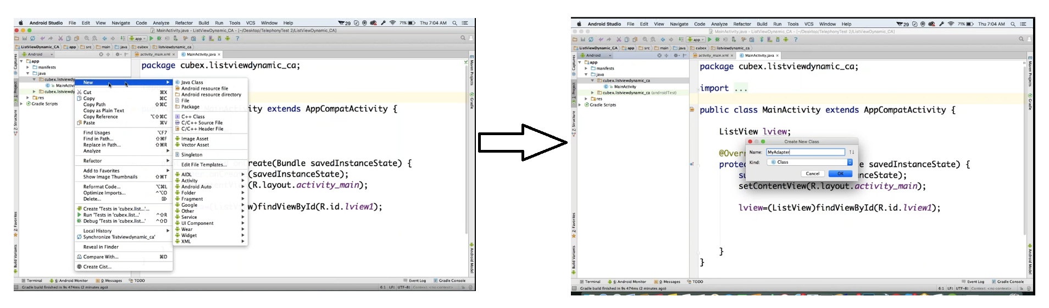
Hands on Example – Customized ListView – Coding Step2
Step : 2 Create your own Adapter class which extends BaseAdapter and Override the methods. In the previous example we used ArrayAdapter. But now we are customizing the view as per our requirement.
Create a class MyAdpater by right click on your Activity folder → New→Java Class

Slide 24
Hands on Example – Customized ListView – Coding Step2
Structure of the MyAdapter.java
public class MyAdapter extends BaseAdapter { @Override public int getCount() { return 0; } @Override public Object getItem(int position) { return null; } @Override public long getItemId(int position) { return 0; } @Override public View getView(int position, View convertView, ViewGroup parent) { return null; } }

Slide 25
Hands on Example – Customized ListView – Coding Step2
Enhancement of MyAdpater.java step by step code
public class MyAdapter extends BaseAdapter { /* 1. Specify the path to retrieve the files - Here my specific folder is sample_images * Create a specific folder sample_images on your device internal memory and copy some images in that folder * 2. Create a File object by passing the path * 3. Using list() method from the file object to retrieve all images files. * This method returns an array of String */ // We discussed two ways to retrieve from phone internal memory.
String path="/storage/sdcard0/sample_images/"; File f=new File(path); String[] files=f.list(); // Hold the list of files @Override // How many values are going to present in the ListView - which is ListView Count public int getCount() { return files.length; // length provide the number of files stored in the array }
// No need to override @Override public Object getItem(int position) { return null; }
// No need to override @Override public long getItemId(int position) { return 0; }

Slide 26
Hands on Example – Customized ListView – Coding Step2
@Override public View getView(int position, View convertView, ViewGroup parent) { return null; } From the above signature of getView(),
The return type of this method is View.
View represents in which format you want to present the UI.
To do this create an XML file which customize the user requirements.
Convert the XML file in to the View with the help of LayoutInflater class. It instantiates a layout XML file into its corresponding View objects. It is an Abstract class. So you cannot create an object directly. Get the object using its factory methods.
XML File
LayoutInflater
View

Slide 27

Hands on Example – Customized ListView – Coding Step3
Creation of activity_myview.xml
Take a look on the expected output in this image.
Each row in a ListView contains
One ImageView
Two TextView, which is used to display the File name and file Size
One Delete Button.
Design your activity_myview.xml using LinearLayout with the above specified components.

Slide 28
Hands on Example – Customized ListView – Coding Step3
Creation of activity_myview.xml : Click res → layout(Right Click)→ New → Layout Resource File
<LinearLayout xmlns:android="http://schemas.android.com/apk/res/android" android:orientation="horizontal" android:layout_width="match_parent" android:layout_height="match_parent"> <ImageView android:layout_width="0dp" android:layout_height="100dp" android:layout_weight="0.2" android:src="@drawable/twitter_logo" android:id="@+id/lview" />
<LinearLayout android:layout_width="0dp" android:layout_height="100dp" android:layout_weight="0.6" android:orientation="vertical" >
<TextView android:layout_width="match_parent" android:layout_height="0dp" android:layout_weight="0.5" android:text="File Name" android:textSize="20sp" android:textColor="#FF0000" android:textStyle="bold" android:gravity="center" android:id="@+id/tv1" /> <TextView android:layout_width="match_parent" android:layout_height="0dp" android:layout_weight="0.5" android:text="File Size" android:textSize="20sp" android:textColor="#0000FF" android:textStyle="bold" android:gravity="center" android:id="@+id/tv2" /> </LinearLayout>
<Button android:layout_width="0dp" android:layout_height="wrap_content" android:layout_weight="0.2" android:text="Del" android:id="@+id/bt1“
/> </LinearLayout>
Notes:
You should place one dummy image in the res → drawable folder. Then use android:src="@drawable/image file name"

Slide 29
Hands on Example – Customized ListView – Coding Step4
MainActivity.java public class MainActivity extends AppCompatActivity { // To access without object reference in the MyAdaper.java static MainActivity mainActivity; ListView lview; @Override protected void onCreate(Bundle savedInstanceState) { super.onCreate(savedInstanceState); setContentView(R.layout.activity_main); mainActivity = this; // Initialize the current activity Reference lview=(ListView)findViewById(R.id.lview1); lview.setAdapter(new MyAdapter()); // Specify the object of your Custom Adapter }
// To refresh the ListView once elements are removed by clicking the Del button public void refresh(){ lview.setAdapter(new MyAdapter()); } }

Slide 30
Hands on Example – Customized ListView – Coding Step2
Implementation of getView() method in MyAdapter.java.
@Override public View getView(int position, View convertView, ViewGroup parent) { // Obtains the LayoutInflater from the given context, in which activity class you want to present LayoutInflater inflater = LayoutInflater.from(MainActivity.mainActivity);
// Convert the XML file into View object View view = inflater.inflate(R.layout.activity_myview,null);
}
Inflate() method
View inflate (int resource, ViewGroup root)
Inflate a new view hierarchy from the
specified xml resource.
Throws InflateException if there is an error.
Parameters
resource | int: ID for an XML layout resource to load (e.g., R.layout.main_page)
root | ViewGroup: Optional view to be the parent of the generated hierarchy.
Returns
View | The root View of the inflated hierarchy. If root was supplied, this is the root View; otherwise it is the root of the inflated XML file.

Slide 31
Hands on Example – Customized ListView – Coding Step2
Implementation of getView() method in MyAdapter.java.
@Override public View getView(int position, View convertView, ViewGroup parent) { // Obtains the LayoutInflater from the given context, in which activity class you want to present LayoutInflater inflater = LayoutInflater.from(MainActivity.mainActivity);
// Convert the XML file into View object View view = inflater.inflate(R.layout.activity_myview,null);
// Configure the Id for individual UI from the activity_myview.xml ImageView imageView = (ImageView)view.findViewById(R.id.lview); TextView fname = (TextView)view.findViewById(R.id.tv1); TextView fsize = (TextView)view.findViewById(R.id.tv2); Button delete = (Button)view.findViewById(R.id.bt1);
/* To display the actual image in each row, already we have the actual path and retrieve each image using position and then make the String into File. Set the image to the ImageView UI using Uri.fromFile() method by passing the File object*/ String new_path = path + files[position]; final File new_file = new File(new_path); imageView.setImageURI(Uri.fromFile(new_file));

Slide 32
Hands on Example – Customized ListView – Coding Step2
Implementation of getView() method in MyAdapter.java.
// Set the file name and file size to the TextView UI fname.setText(files[position]); // Retrieve the file name fsize.setText(new_file.length() + " bytes"); // Retrieve the file size
// Remove the file once click the Del button by implementing OnClickListener()
delete.setOnClickListener(new View.OnClickListener() { @Override public void onClick(View v) { new_file.delete(); // helps to remove the file MainActivity.mainActivity.refresh(); // Refresh the ListView once the file is removed } }); return view; // Return the View } }

Slide 33
Hands on Example – Customized ListView – Step 5
Run your App to get the Expected result.

Slide 34
Other Views
We learned ListView in this course
Like that Android supports several views which we are not covered
GridView - This layout displays a scrolling grid consisting of rows and columns
GalleryView - Provides layout to view all the images in a gallery view
RecyclerView - RecyclerView is like traditional ListView widget, but with more flexibility to customizes and optimized to work with larger datasets.
SurfaceView- Provides a dedicated drawing surface embedded inside of a view hierarchy. To handle Graphics and Animation.

